Slide 1
Rounding to three decimal places
Estimation and rounding

Slide 2
how to use Oak lessons

Slide 3
I can round numbers to three decimal places.

Slide 4
Round − To change a number into another number that is approximately the same value but is easier to work with. E.g. round 561 to the nearest 10 is 560.

Slide 5

Rounding to three decimal places
Representing decimals on a number line
Rounding to three decimal places

Slide 6
Representing decimals on a number line
Write down a number which fits on this number line.
2
3
E.g. 2.1, 2.56, 2.8

Slide 7
Representing decimals on a number line
Write down a number which fits on this number line.
2.5
3
E.g. 2.6, 2.73, 2.9

Slide 8
Representing decimals on a number line
Write down a number which fits on this number line.
2.9
3
E.g. 2.93, 2.956, 2.9708

Slide 9
Representing decimals on a number line
Write down a number which fits on this number line.
2.95
3
E.g. 2.951, 2.956, 2.9708

Slide 10
Representing decimals on a number line
The arrow is pointing to the midpoint of the number line.
What number is the arrow pointing to?
2.5
2
3
If it is not obvious you can find half of the sum of the 2 numbers.
Midpoint = (2 + 3) ÷ 2 = 5 ÷ 2 = 2.5

Slide 11
Representing decimals on a number line
The arrow is pointing to the midpoint of the number line.
What number is the arrow pointing to?
2.55
2.5
2.6
If it is not obvious you can find half of the sum of the 2 numbers.
Midpoint = (2.5 + 2.6) ÷ 2 = 5.1 ÷ 2 = 2.55

Slide 12
Representing decimals on a number line
The arrow is pointing to the midpoint of the number line.
What number is the arrow pointing to?
2.555
2.55
2.56
If it is not obvious you can find half of the sum of the 2 numbers.
Midpoint = (2.55 + 2.56) ÷ 2 = 5.11 ÷ 2 = 2.555

Slide 13
Representing decimals on a number line
The arrow is pointing to the midpoint of the number line.
What number is the arrow pointing to?
2.5555
2.555
2.556
If it is not obvious you can find half of the sum of the 2 numbers.
Midpoint = (2.555 + 2.556) ÷ 2 = 5.111 ÷ 2 = 2.5555

Slide 14
Representing decimals on a number line
Round 0.5672 to 3 decimal places.
The 3rd decimal place, use this as the lower value.
Identify the numbers to 3 decimal places either side of 0.5672.
0.5672
0.567
0.5675
0.568
Increase the thousandths digit by 1.
Find the halfway point.
Decide which of the 2 numbers our value is closest to.
0.5672 = 0.567 (3 d.p.)

Slide 15
Representing decimals on a number line
Round 0.34081 to 3 decimal places.
The 3rd decimal place, use this as the lower value.
Identify the numbers to 3 decimal places either side of 0.34081.
0.34081
0.340
0.3405
0.341
Increase the thousandths digit by 1.
Find the halfway point.
Decide which of the 2 numbers our value is closest to.
0.34081 = 0.341 (3 d.p.)

Slide 16
Representing decimals on a number line
Round 12.039501 to 3 decimal places.
The 3rd decimal place, use this as the lower value.
Identify the numbers to 3 decimal places either side of 12.039501.
12.039501
12.039
12.0395
12.040
Increase the thousandths digit by 1.
Find the halfway point.
Decide which of the 2 numbers our value is closest to.
12.039501 = 12.040 (3 d.p.)

Slide 17
Representing decimals on a number line
Round 0.349821 to 3 decimal places.
Identify the numbers to 3 decimal places either side of 0.349821.
0.349821
0.349
0.3495
0.350
Identify the halfway point.
0.349821 = 0.350 (3 d.p.)

Slide 18
Representing decimals on a number line
Round 0.349821 to 3 decimal places.
Round 0.8429 to 3 decimal places.
Identify the numbers to 3 decimal places either side of 0.349821.
Identify the numbers to 3 decimal places either side of 0.8429.
0.349821
0.8429
0.349
0.3495
0.350
0.842
0.8425
0.843
Identify the halfway point.
Identify the halfway point.
0.349821 = 0.350 (3 d.p.)
0.8429 = 0.843 (3 d.p.)

Slide 19
Representing decimals on a number line
Round each number in the table to 3 decimal places.
Decimal | Number line | Answer
0.0068
0.00648
0.06408
0.0648

Slide 20
Representing decimals on a number line
2) Round each number in the table to 3 decimal places.
Decimal | Number line | Answer
0.64848
0.64884
6.0648
6.08684

Slide 21
Representing decimals on a number line
Round each number in the table to 3 decimal places.
Decimal | Number line | Answer
0.0068 |  | 0.007
0.00648 |  | 0.006
0.06408 |  | 0.064
0.0648 |  | 0.065
0.006
0.0065
0.007
0.006
0.0065
0.007
0.064
0.0645
0.065
0.064
0.0645
0.065

Slide 22
Representing decimals on a number line
2) Round each number in the table to 3 decimal places.
Decimal | Number line | Answer
0.64848 |  | 0.648
0.64884 |  | 0.649
6.0648 |  | 6.065
6.08684 |  | 6.087
0.648
0.6485
0.649
0.648
0.6485
0.649
6.064
6.0645
6.065
6.086
6.0865
6.087

Slide 23
Rounding to three decimal places
Representing decimals on a number line
Rounding to three decimal places

Slide 24
Rounding to three decimal places
Round 0.67839 to 3 decimal places.
HMn | TMn | Mn | HTh | TTh | Th | H | T | O | T | H | Th | TTh | HTh | Mh
 |  |  |  |  |  |  |  | 0 | 6 | 7 | 8 | 3 | 9
.
th
th
th
th
th
th
.
Halfway would show a 5 in this column,
3 is less than 5.
Identify the thousandths column as this is the 3rd decimal place.
Consider the digit in the ten thousandths column, the column to the right.
Therefore, we round down to the lower value.
0.67839 = 0.678 (3 d.p.)

Slide 25
Rounding to three decimal places
Round 1.9037 to 3 decimal places.
HMn | TMn | Mn | HTh | TTh | Th | H | T | O | T | H | Th | TTh | HTh | Mh
 |  |  |  |  |  |  |  | 1 | 9 | 0 | 3 | 7
.
th
th
th
th
th
th
.
Halfway would show a 5 in this column,
7 is greater than 5.
Identify the thousandths column as this is the 3rd decimal place.
Consider the digit in the ten thousandths column, the column to the right.
Therefore, we round up to the higher value.
1.9037 = 1.904 (3 d.p.)

Slide 26
Rounding to three decimal places
Round 0.67839 to 3 decimal places.
HMn | TMn | Mn | HTh | TTh | Th | H | T | O | T | H | Th | TTh | HTh | Mh
 |  |  |  |  |  |  |  | 0 | 6 | 7 | 8 | 3 | 9
.
th
th
th
th
th
th
.
Halfway would show a 5 in this column,
3 is less than 5.
Identify the thousandths column as this is the 3rd decimal place.
Consider the digit in the ten thousandths column, the column to the right.
Therefore, we round down to the lower value.
0.67839 = 0.678 (3 d.p.)

Slide 27
Rounding to three decimal places
Round 0.0495 to 3 decimal places.
HMn | TMn | Mn | HTh | TTh | Th | H | T | O | T | H | Th | TTh | HTh | Mh
 |  |  |  |  |  |  |  | 0 | 0 | 4 | 9 | 5
.
th
th
th
th
th
th
.
Halfway would show a 5 in this column,
this is exactly halfway.
Identify the thousandths column as this is the 3rd decimal place.
Consider the digit in the ten thousandths column, the column to the right.
Therefore, we round up to the higher value.
0.0495 = 0.050 (3 d.p.)

Slide 28
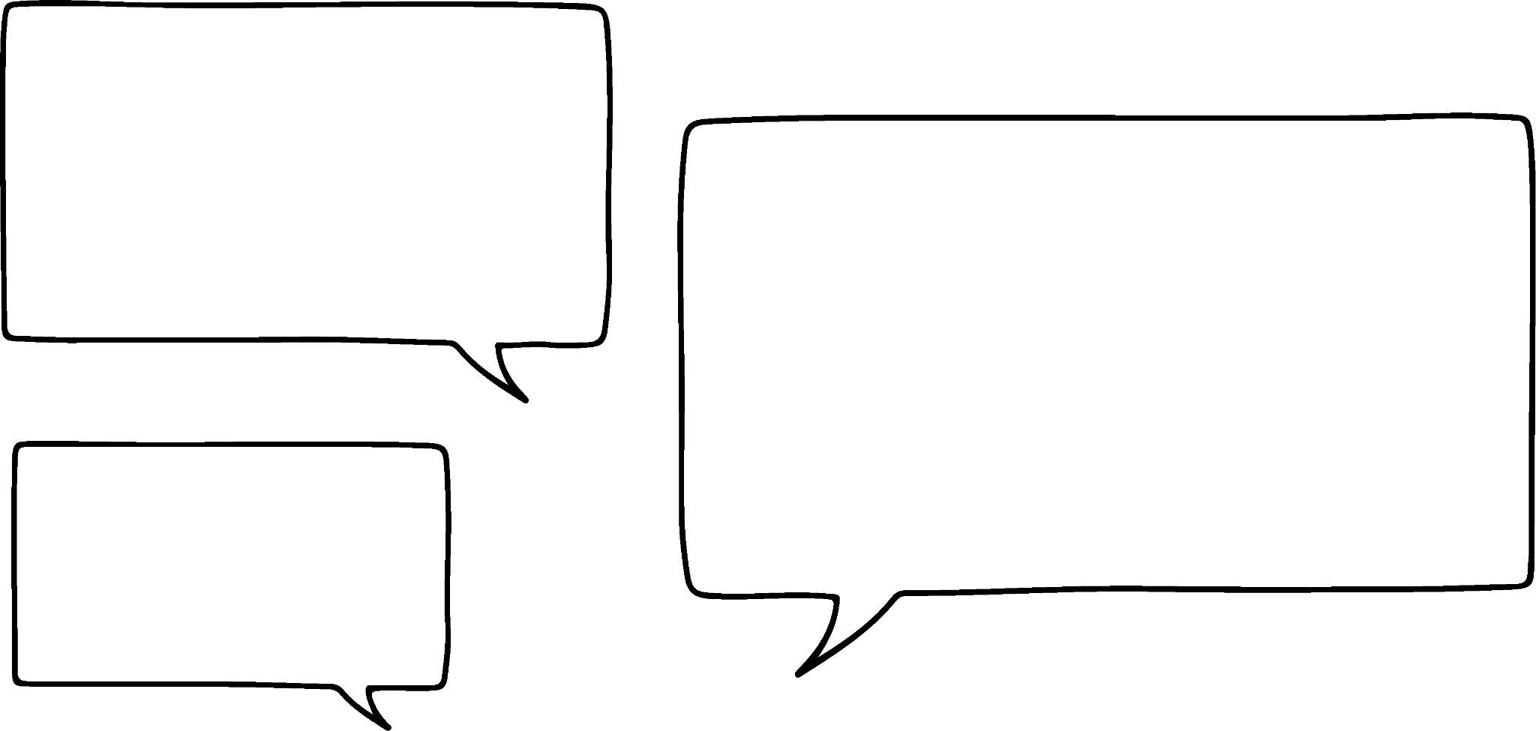
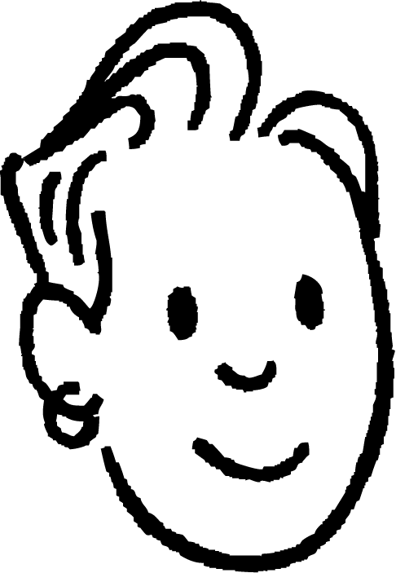
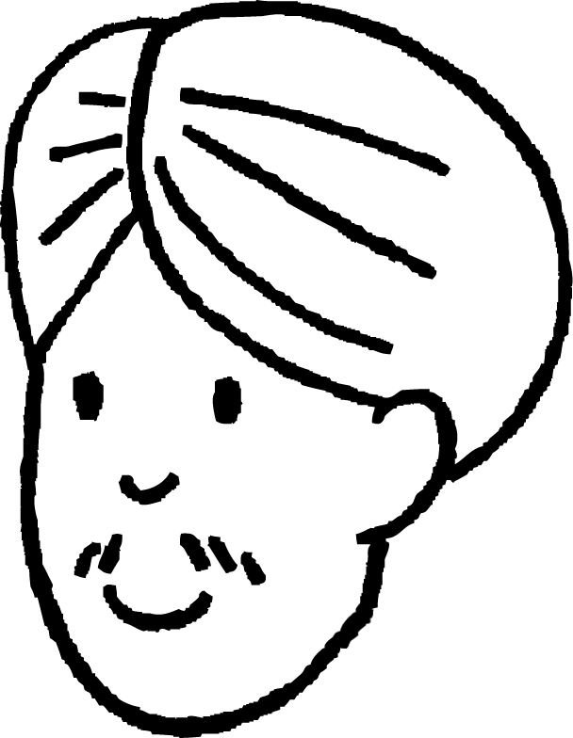
Rounding to three decimal places
Andeep and Sam have rounded 0.0495 to 3 decimal places.
My answer is 0.050
My answer is 0.05
Sam
Andeep
Whose answer is correct?
Even though we often consider 0.05 and 0.050 to be equivalent, if they are not exact values we cannot be sure.
Sam’s value shows that they have considered the value in the ten thousandths column.

Slide 29

Rounding to three decimal places
Which of the following round to 13.470 when rounded to 3 decimal places?
13.4693
13.4695
13.4703
13.4705

Slide 30
Rounding to three decimal places
Round each of the following to 3 decimal places and find them in the number search.
0.4583 h) 4.59289
1.5737 i) 5.9371
3.0378 j) 3.98972
6.8796 k) 3.3841
2.0305 l) 0.00692
27.2389 m) 7.3498
0.05682 n) 3.00149
2 | 3 | 9 | . | 7 | 0 | 6 | 2 | 9 | 5 | 6 | 8
3 | 6 | . | 8 | 7 | 2 | 4 | 0 | . | 3 | . | 3
2 | . | 0 | 3 | 1 | . | 1 | 5 | 6 | 6 | 8 | 2
5 | 3 | 2 | . | 8 | 3 | . | 8 | 5 | 4 | 8 | 0
. | 7 | 9 | 0 | . | 4 | 5 | 8 | 6 | . | 0 | ‘
9 | . | 2 | 3 | 8 | . | 7 | 6 | 2 | 5 | 0 | 7
7 | 2 | 6 | 8 | 3 | 7 | 4 | 5 | . | 9 | 3 | .
3 | 9 | 8 | 5 | 7 | 2 | 7 | . | 2 | 3 | 9 | 3
5 | . | 1 | 5 | 3 | 3 | . | 9 | 9 | 0 | 7 | 5
3 | 4 | 0 | 7 | 8 | 2 | 7 | 3 | 5 | 6 | . | 0
9 | . | 2 | 0 | . | 0 | 0 | 7 | 0 | 7 | 3 | 4
0 | 1 | . | 2 | 1 | 9 | 2 | . | 1 | 2 | 5 | 2

Slide 31

Rounding to three decimal places
2) Using the clues, find the numbers being described:
Clue 1 − I am between and 1
Clue 2 − If you round me to 2 decimal places I round up.
Clue 3 − My tenths and thousandths digits are the same.
Clue 4 − My hundredths digit is a quarter of my tenths digit. I am .

Slide 32
Rounding to three decimal places
2) Using the clues, find the numbers being described:
b) Clue 1 − When rounded to 1 decimal place I am 6.8
Clue 2 − When rounded to 2 decimal places I round up.
Clue 3 − The sum of my 5 digits is 29
Clue 4 − My first digit is the same as my last digit.
Clue 5 − The digits in the tenths & hundredths columns are multiples of 4
I am .

Slide 33
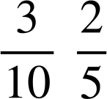
Rounding to three decimal places
2) Using the clues, find the numbers being described:
c) Clue 1 − I am between and
Clue 2 − When rounding to 3 decimal places my thousandths digit stays the same.
Clue 3 − When rounded to 2 decimal places I am 0.32
Clue 4 − The sum of my 5 digits is 9
Clue 5 − I only have 1 odd digit (zero is even).
Clue 6 − My largest digit is in the ten thousandths column.
I am .

Slide 34
Rounding to three decimal places
Round each of the following to 3 decimal places and find them in the number search.
0.4583 h) 4.59289
1.5737 i) 5.9371
3.0378 j) 3.98972
6.8796 k) 3.3841
2.0305 l) 0.00692
27.2389 m) 7.3498
0.05682 n) 3.00149
2 | 3 | 9 | . | 7 | 0 | 6 | 2 | 9 | 5 | 6 | 8
3 | 6 | . | 8 | 7 | 2 | 4 | 0 | . | 3 | . | 3
2 | . | 0 | 3 | 1 | . | 1 | 5 | 6 | 6 | 8 | 2
5 | 3 | 2 | . | 8 | 3 | . | 8 | 5 | 4 | 8 | 0
. | 7 | 9 | 0 | . | 4 | 5 | 8 | 6 | . | 0 | ‘
9 | . | 2 | 3 | 8 | . | 7 | 6 | 2 | 5 | 0 | 7
7 | 2 | 6 | 8 | .3 | 7 | 4 | 5 | . | 9 | 3 | .
3 | 9 | 8 | 5 | 7 | 2 | 7 | . | 2 | 3 | 9 | 3
5 | . | 1 | 5 | 3 | 3 | . | 9 | 9 | 0 | 7 | 5
3 | 4 | 0 | 7 | 8 | 2 | 7 | 3 | 5 | 6 | . | 0
9 | . | 2 | 0 | . | 0 | 0 | 7 | 0 | 7 | 3 | 4
0 | 1 | . | 2 | 1 | 9 | 2 | . | 1 | 2 | 5 | 2
0.458
1.574
3.038
6.880
2.031
27.239
0.057
4.593
5.937
3.990
3.384
0.007
7.350
3.001

Slide 35
Rounding to three decimal places
2) Using the clues, find the numbers being described:
a) Clue 1 − I am between and 1
Clue 2 − If you round me to 2 decimal places I round up.
Clue 3 − My tenths and thousandths digits are the same.
Clue 4 − My hundredths digit is a quarter of my tenths digit. I am.
0.828

Slide 36
Rounding to three decimal places
2) Using the clues, find the numbers being described:
b) Clue 1 − When rounded to 1 decimal place I am 6.8
Clue 2 − When rounded to 2 decimal places I round up.
Clue 3 − The sum of my 5 digits is 29
Clue 4 − My first digit is the same as my last digit.
Clue 5 − The digits in the tenths & hundredths columns are multiples of 4
I am
6.8456

Slide 37
Rounding to three decimal places
2) Using the clues, find the numbers being described:
c) Clue 1 − I am between and
Clue 2 − When rounding to 3 decimal places my thousandths digit stays the same.
Clue 3 − When rounded to 2 decimal places I am 0.32
Clue 4 − The sum of my 5 digits is 9
Clue 5 − I only have 1 odd digit (zero is even).
Clue 6 − My largest digit is in the ten thousandths column.
I am
0.3204

Slide 38
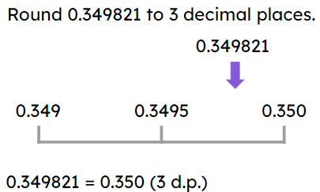
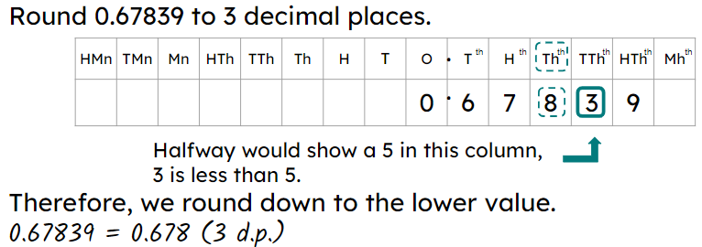
Rounding to three decimal places
Rounding to 3 decimal places is the same as rounding to the nearest thousandth.
A number line can be useful when rounding to 3 decimal places.
E.g.
A place value grid can be used when rounding to 3 decimal places.
E.g.

Slide 39

© Oak National Academy 2024.
Produced in partnership with Mathematics in Education and Industry.
Licensed on the Open Government Licence v3.0, except where otherwise stated. See Oak terms and conditions.

